Slide 1
iClothe Application
Team 6

Slide 2

Team 6
Iris Fabros
Adeel Mela
Sahil Patel
Savneet Singh Baluja
Burcu Atik
Thufayle Jamal
Nitin Teotia
Cameron Dyke

Slide 3
Requirements Exploration Process

Slide 4
Problem to Address
Confidence in online purchases specifically clothing and makeup
Decreased returns
Negative customer experience
Environmental impact
Business costs
Ability to purchase clothing and makeup items without second guessing suitability

Slide 5
Our Vision
Use AI to detect body shape, skin type and clothing size with minimal user inputs
Provide user visual feedback on clothing look and fit
Provide user with visual feedback on makeup color and look on their own skin tone
White label product for wide industry adoption
Allow direct connection to brand partner for purchases

Slide 6
Steps in Elicitation
Completed survey of friends, family and coworkers who would be within the target audience
Followed up to complete interviews to better clarify customer expectations

Slide 7
STAGES | AWARENESS |  | CONSIDERATION | PURCHASE |  | RETENTION
JOURNEY | Buying clothing and make up online and finding that they need to be retuned as they are not as expected | Looking for ways to ensure that they have confidence in their online make up and clothing purchases | They found iClothe on social media and decide that this is a unique solution, and they decide to give it a try. The application works well, and the clothing looks great on their avatar. | They create a look that they like and send to a friend, the friend likes the look, so they decide to buy the outfit | The outfit arrives and everything fits perfectly, and the colors look great on them | One week after they’re last purchase the application recommends a number of new items to try | A friend thinks they look great and asks where they got the outfit
GOALS | To buy clothing and makeup online | To find online clothing and makeup products that fit and look the way they expect | To try out the application to see if it works as advertised | To purchase clothing that looks good and fits well | Validate that the application had done a good job of measuring and matching both size and color | To stay informed on the latest fashion trends | To share iClothe with their friends
ACTIONS | Going to an online retailer and making a purchase | Researching online methods of ensuring good fit and color match | Downloading application and adding clothing and make up to avatar | Saving the look they created, sending the look to a friend and then purchasing the outfit | Trying on the clothing that they had purchased and the makeup they had purchased | Clicking on the prompt that the brand provides to evaluate in iClothe | Recommending iClothe application to a friend
THINKING | Why doesn’t the sizing work and why doesn’t the colors look the same as on screen | How can I ensure that I don’t have the same thing happen next time I buy clothing and makeup online | I hope that this application will solve my issues | Excited to show my new look I created | Wow! I’m impressed that this application was able to nail my size and the color coordination | I remember this brand and application, let’s see what’s new | I’m impressed with how well this application works; I want to tell my friends
CHANNELS | Online clothing and make up retailers | Online search engines | Instagram | iClothe Application | Online clothing and make up retailers | iClothe Application | iClothe Application
Excited |  |  |  | J | J
Happy |  |  |  |  |  | J | J
Neutral |  |  | K
Confused |  | K
Frustrated | L

Slide 8
Context:
An app directed to online clothing and makeup shoppers to help them assess the sizing of their purchases and plan their outfits. The goal of the scenario is to construct a look to share with a friend. Jamie completes the look and sends the resulting image to a friend to assess for her.
Scenario:
Jamie heard of a hot new brand available for purchase now online, she doesn’t have the ability to go to a physical location as there are none near her and she want to order a new outfit before they are all sold out, but this would be a significant purchase and she wants to ensure her purchase fits perfectly first. So, Jamie goes to the brands iClothe integration app and select the products she wants, applying them to her avatar and creating a new look. She then is able to see exactly how the clothing she wants to purchase will fall on her body and what size to purchase. Jamie can then check out online with confidence in size and fit.

Slide 9
Finalized Use Cases
UC01
Input Measurement – Iris
UC02
Create Account – Thufayle
UC03
Share Look – Brucu
UC04
Delete Profile – Nitin
UC05
Purchase Item – Cameron
UC06
Search Product – Savneet
UC07
Delete Look – Sahil
UC08
Update Profile - Adeel

Slide 10
Design Process

Slide 12
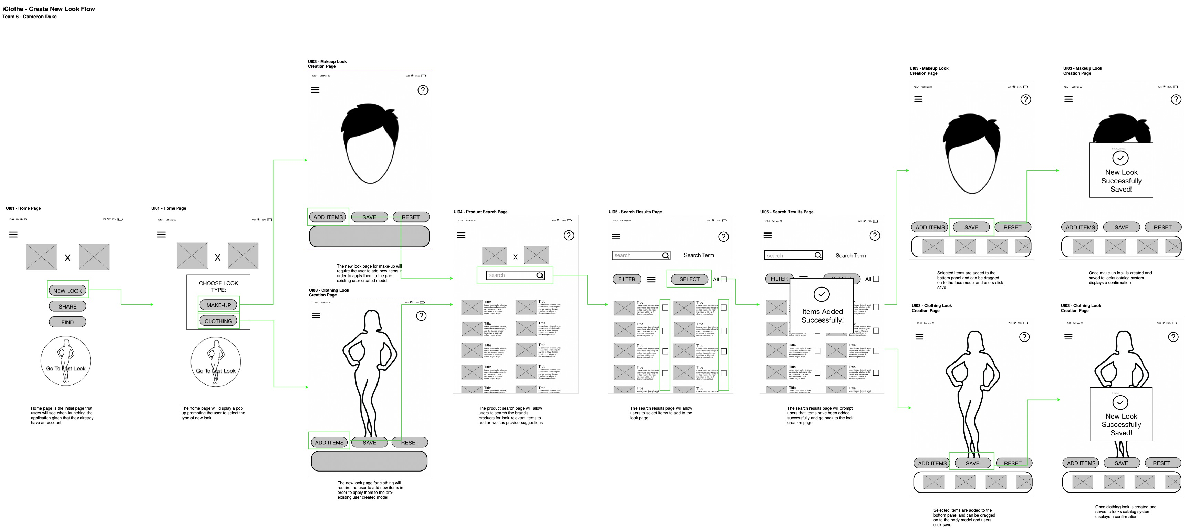

Slide 13
Figma Hi-Fi Prototype

